Slide 1
Subversion User Training

Slide 2
Agenda
Introduction
Architecture
Working cycle
Locking
SVN Properties
Managing versions
Branching strategies
Merging
Configurations

Slide 3
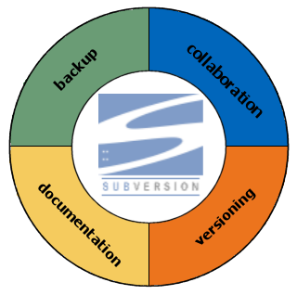
Introduction
What is Subversion?

Slide 4
Introduction
Testimonials
670431 Revisions
Testimonial:
Stuart Robertson of Absolute Systems, Inc
In the last 4 months we have migrated all of our internal product source repositories from XXX to SVN […]
Our largest SVN repository is now 3.7GB and currently has 68806 revisions. We are running SVN 1.0.1 + Apache 2.0.48 on Linux. ...
SVN is a superb piece of work, and it is a *huge* step forward from XXX. To put things in perspective... previously we had 26 XXX databases for one product
Gustavo Niemeyer of Conectiva Linux (25 February 2004)‏
Shortening the history a lot, 1 year and 6 months ago, the first revision was committed into our repository.
[...]
Since then, 5 complete Conectiva Linux distributions were committed into the repository, and every single update in the distribution is done using Subversion. We've already surpassed 50000 revisions, in a 30GB repository. Even though we have had space, memory, and other kinds of problems around the repository, I'm proud to say we have never lost a single bit of information since then.
More testimonials on: http://subversion.tigris.org/testimonials.html

Slide 5
Architecture

Slide 6




Architecture
Overview
Client Interface
Repository Interface
FSFS
Apache
mod_dav
GUI client
apps
Repository
access
mod_dav_svn
DAV
Client
Library
Internet
(Any TCP/IP Network)‏
SVN
svnserve
Commandline
client apps
Local
Subversion
Repository
Working Copy Management
Library
Berkley DB

Slide 7
Architecture
Access URLs
file://
Direct repository access to local or network drive.)‏
http://
Access via WebDAV protocol to Subversion-aware Apache server.)‏
https://
Same as http://, but with SSL encryption.
svn://
Unauthenticated TCP/IP access via custom protocol to an svnserve server.
svn+ssh://
Authenticated, encrytped TCP/IP access via custom protocol to an svnserve server.
Notes:
Two locations of SVN repositories
On a local filesystem
Typically used for a single developer
Accessed via direct file read/write access
Requires that users have local accounts
Uses filesystem and user/group security
On a remote system
Accessed via a HTTP or HTTPS connection
Does not require that users have accounts on the server
Use Apache style authentication

Slide 8
Architecture
Access URLs
file://hostname/path/to/repos
  On local machines the hostname part must be absent or localhost.
This results in a path like this one:
  file:///path/to/repos
On Windows you have to specify the drive where to find the repository:
  file:///X:/path/to/repos
Notes:
Two locations of SVN repositories
On a local filesystem
Typically used for a single developer
Accessed via direct file read/write access
Requires that users have local accounts
Uses filesystem and user/group security
On a remote system
Accessed via a HTTP or HTTPS connection
Does not require that users have accounts on the server
Use Apache style authentication

Slide 9



Architecture
The revision numbers
0 1 2 3 4
0
1
2
3
4
1
1
1
4
1
1
1
1
1
1
1
1
1
1
1
4
2
3
3
2
2
2
3
3
3
3
Notes:
Subversion
Revision numbers are global across the whole repository
Identify how the entire repository looks at that instant in time
A commit creates a snapshot of the entire tree in the repository at that revision number
Allows users to say, “Hey so-and-so, go get revision 1432 of XYZ and try to compile it.”
Before an update, both bar.c and foo.c are at revision 25
Modify bar.c and commit
Then update the working copy
Now bar.c and foo.c are at revision 26, except that foo.c in revision 25 and 26 are identical
No additional space in repository required, i.e. a cheap copy or a symbolic link is made

Slide 10

Architecture
The working copy
“Checking out” creates a working copy of a specific revision of the repository
working copy
repository
2
3
2
.svn
1
SVNs config data. Do not edit these folders!
0
.svn

Slide 11
The working cycle
-single person-

Slide 12






The Working Cycle
-single person-
get content
svn checkout
svn update
Submit your changes
svn commit
100
101
Subversion
Repository
Make changes
svn add
svn move
svn delete

Slide 13



The Working Cycle
Check Out
A check out will transfer the project’s content
from the repository server
to the client machine.
The client machine
Repository Server
2
Check out a working copy
2
1
0

Slide 14
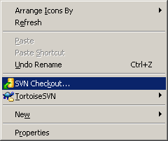
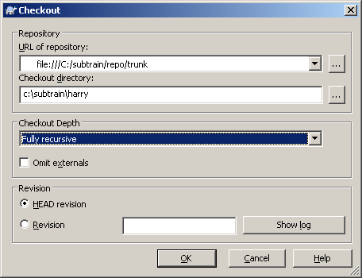

The Working Cycle
Check Out
sparse checkout
svn checkout file:///c:/subtrain/repo/trunk c:\subtrain\harry

Slide 15
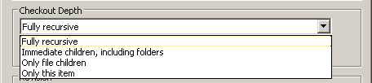
The Working Cycle
Sparse Check Out
Fully recursive
Immediate children,
including folders
Only file children
only this item
Important for restructuring repository(eg. /branches directory)!

Slide 16









The Working Cycle
TortoiseSVN Icon Overlays
normal
modified
conflict
added
deleted
non-versioned
ignored
readonly
locked

Slide 17






The Working Cycle
Warning
WARNING
Never move, delete, copy files or create directories without the Subversion commands:
  svn move
  svn delete
  svn copy
  svn mkdir
Easy if using TortoiseSVN as it is integrated directly in Windows Explorer

Slide 18
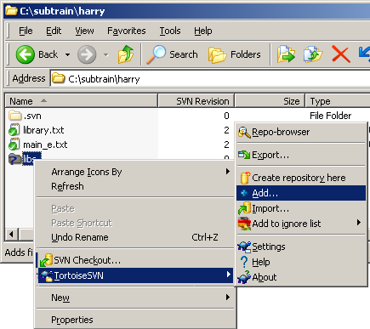
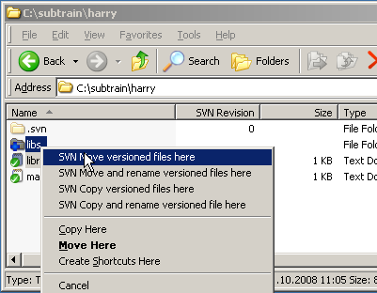

The Working Cycle
Adding and moving files
add folder/files via contextmenu to SVN
move or copy folder/files via dragging with
right mouse button

Slide 19

The Working Cycle
Commit
The client machine
Repository Server
2
commit changes to repository
3
2
1
0
A check out will transfer the project’s content
from the repository server
to the client machine.

Slide 20
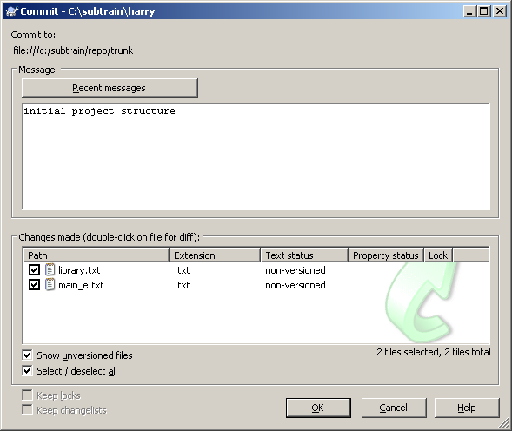
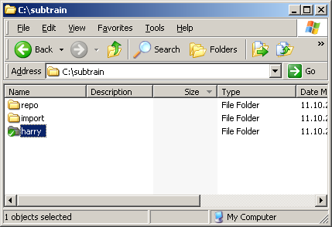
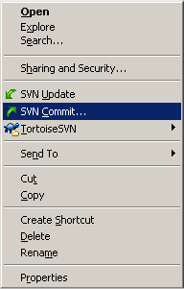
The Working Cycle
Commit
svn commit -m"initial project" c:\subtrain\harry

Slide 21
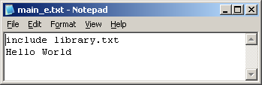
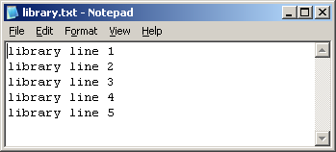
The Working Cycle
Exercise I: adding files
checkout trunk (into a folder named „harry“)
create two files in your working copy(fill them with these textlines):
main_e.txt
library.txt
commit your changes as „initial project“

Slide 22
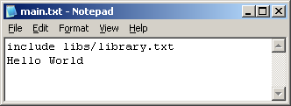
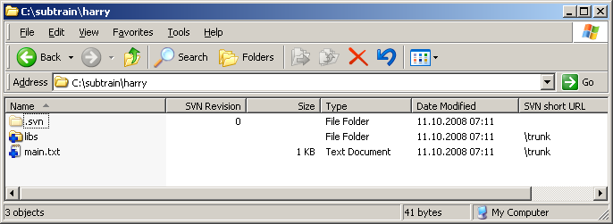
The Working Cycle
Exercise II: restructuring files
rename main_e.txt into main.txt
create a folder named libs and add it to SVN
move library.txt into libs (modify main.txt accordingly!)‏
commit your changes as „restructuring project“

Slide 23
The working cycle
-teamwork-

Slide 24



The working Cycle
Teamwork
get content
Submit your changes
svn commit
svn checkout
svn update
106
100
Merge your changes
Resolve conflicts
Make changes
svn diff
svn resolved
svn add
svn move
svn delete
Subversion
Repository
105
See what was changed
in the repository in the meantime
Update your local copy
svn update
svn status -u

Slide 25
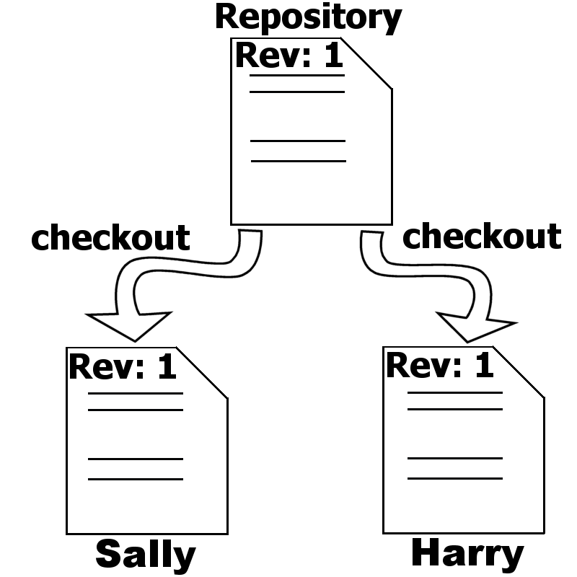
The working Cycle
Teamwork 1/5
Harry and Sally both check out a directory in their repository.
Both will get the same revision of this particular directory copied to their computer.
Their working copy.

Slide 26
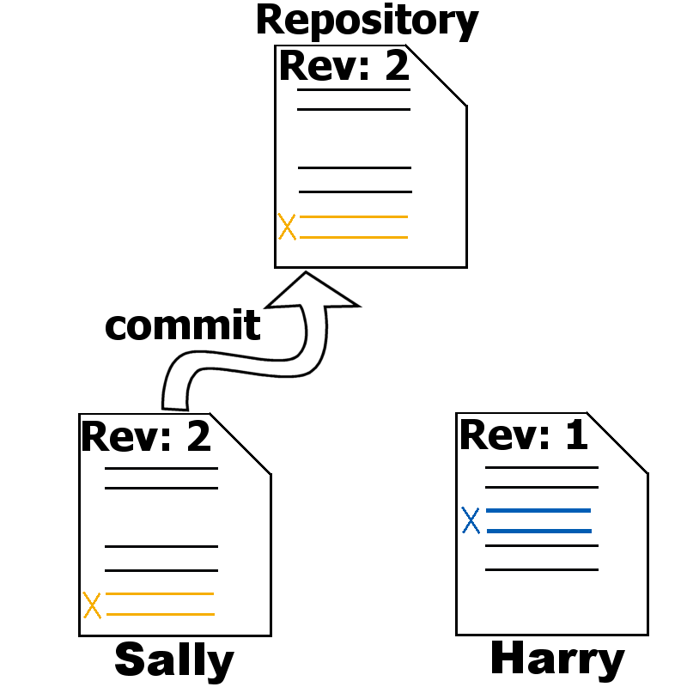
The working Cycle
Teamwork 2/5
Harry and Sally change different lines in the same file.
Sally commits first and creates revision 2.

Slide 27
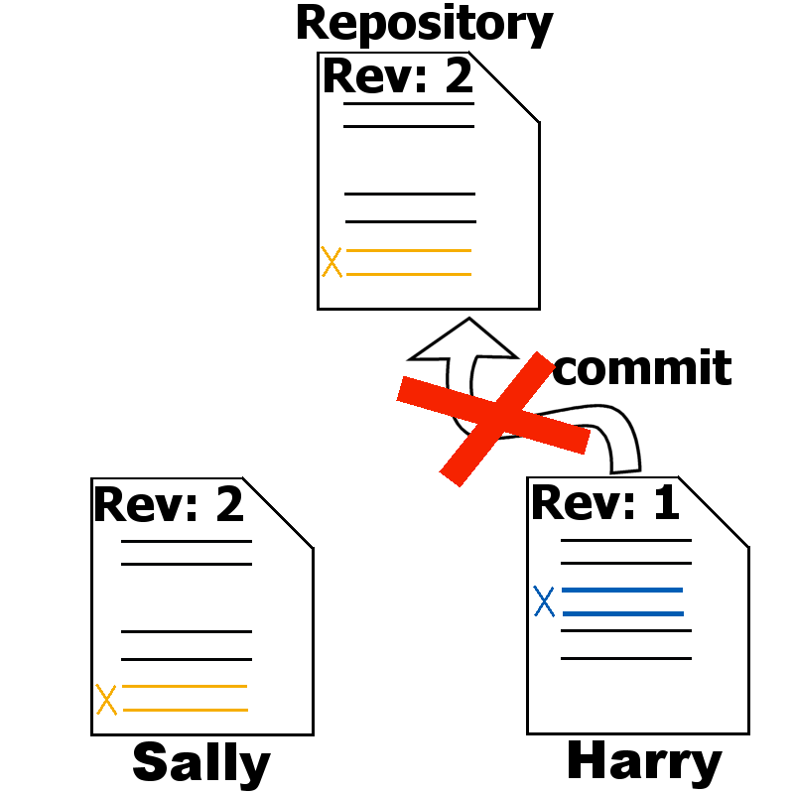
The working Cycle
Teamwork 3/5
As Harry tries to commit his changes, her receives an error telling him that his working copy is probably out of date.
His commit fails.

Slide 28
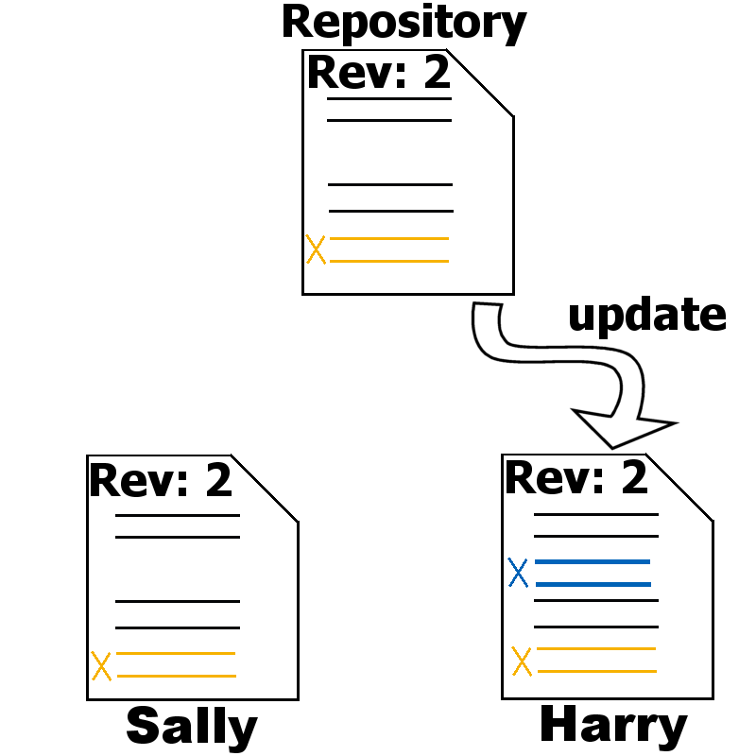
The working Cycle
Teamwork 4/5
Harry has to update his working copy and SVN will integrate Sallies changes into his working copy.

Slide 29
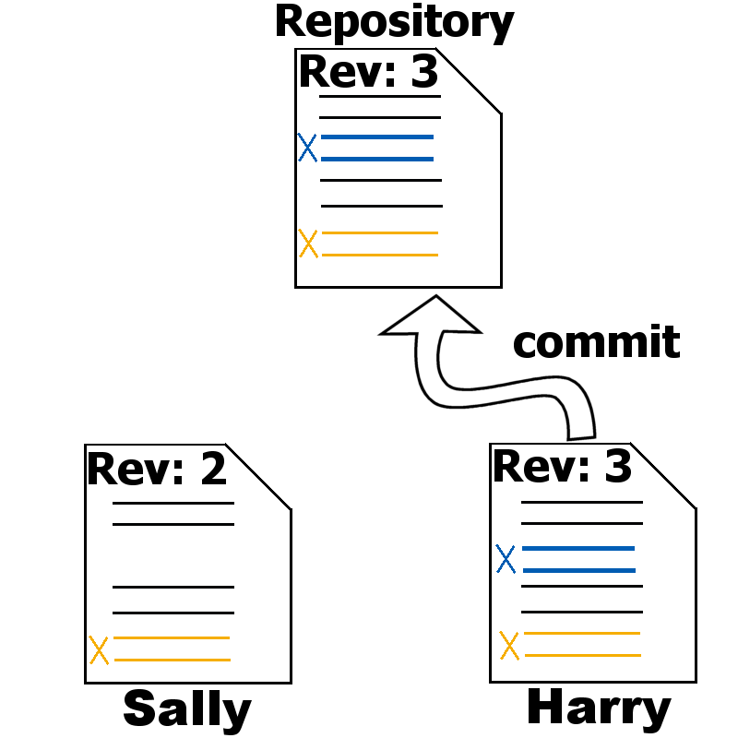
The working Cycle
Teamwork 5/5
Now Harry is ready to commit his changes.
He will create revision 3.

Slide 30
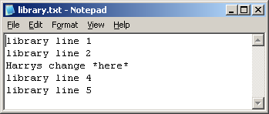
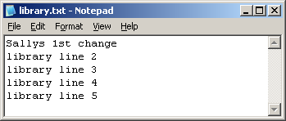
The Working Cycle
Exercise III: teamwork
check out trunk a second time into a folder called „sally“
change the third line in Harrys workingcopy
commit Harrys changes as „Harrys 1st changes in our library“
change the first line in Sallys workingcopy and try to commit
update Sallys workingcopy
commit Sallys changes as „Sallys 1st changes added“

Slide 31

Teamwork
Conflicts
How does a conflict evolve?

Slide 32

Teamwork
Conflicts 1/6
Harry and Sally will check out their repo again.
This time they will change the same lines in this particular file.

Slide 33
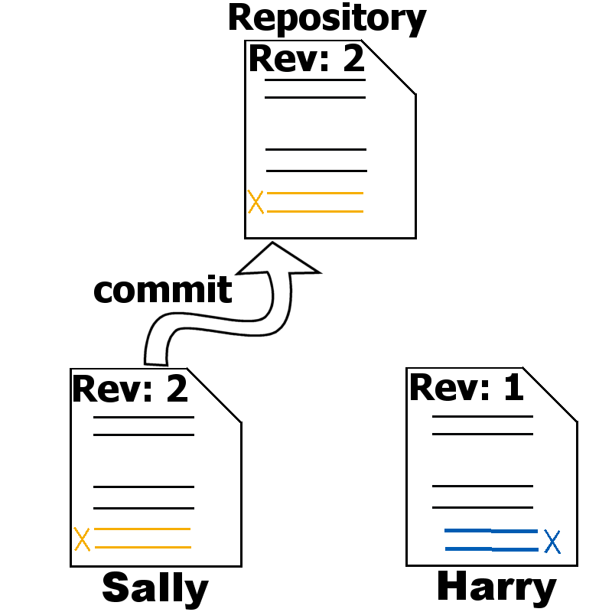
Teamwork
Conflicts 2/6
Sally commits her changes and creates a new revion.
Her changes had been submitted to the repository

Slide 34
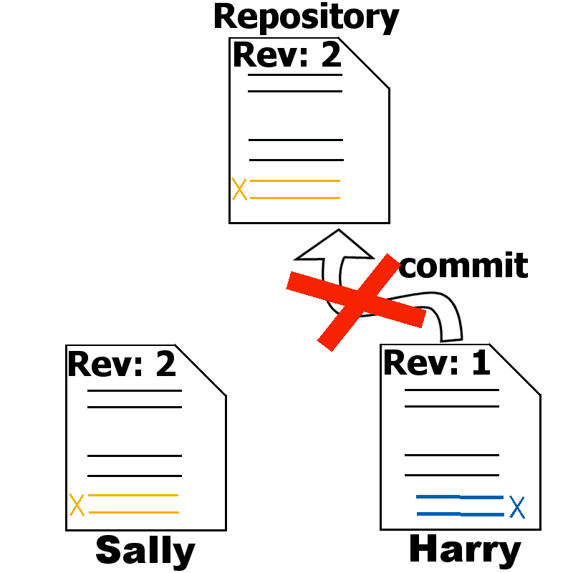
Teamwork
Conflicts 3/6
As Harry tries to commit his changes, he receives the well known “out-of-date”-error and an advice to update his working copy.

Slide 35
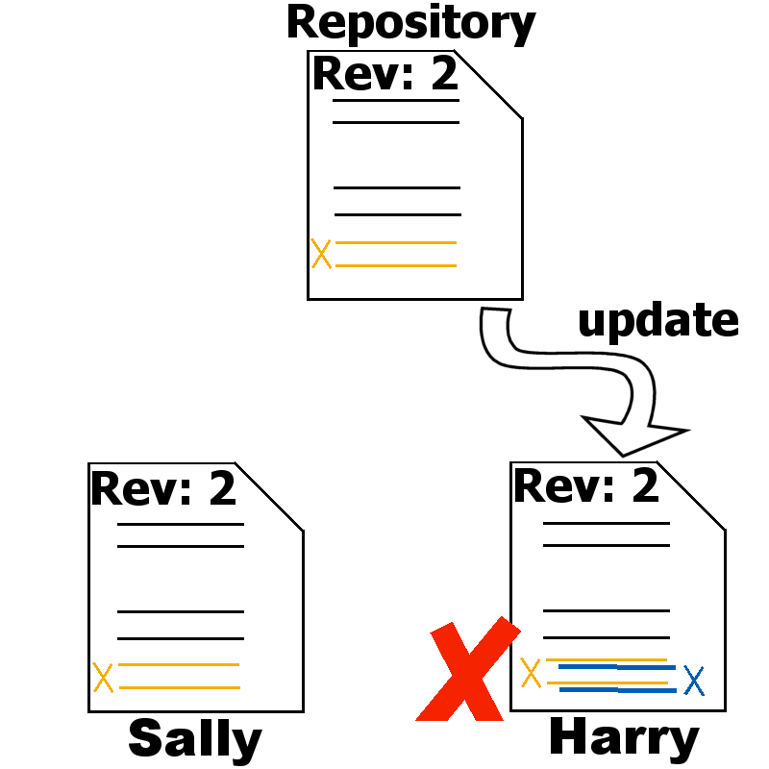
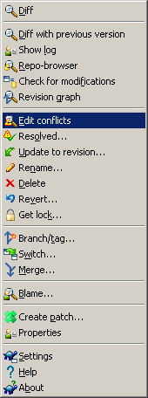
Teamwork
Conflicts 4/6
As both Harry and Sally had changed the same lines, SVN cannot decide how to merge Harrys changes and the changes from the repository.
So SVN rises a conflict which must be resolved by Harry.

Slide 36
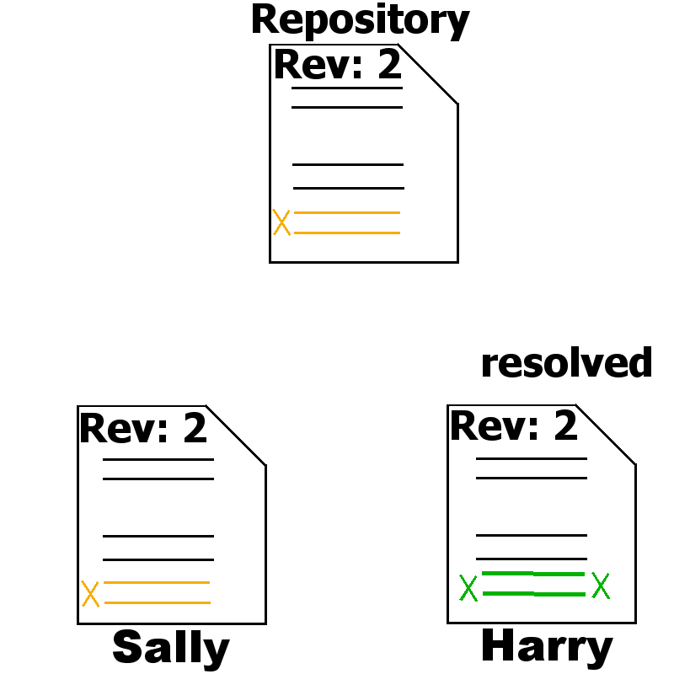
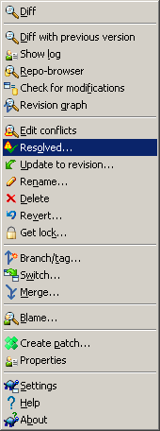
Teamwork
Conflicts 5/6
Harry cannot commit a file which is in a conflict state.
Harry has to resolve the conflict/s and notifies SVN via svn resolved.

Slide 37
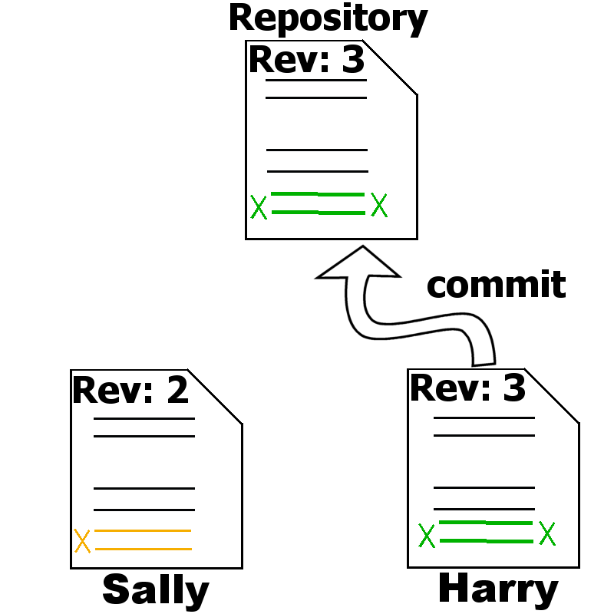
Teamwork
Conflicts 6/6
Harry will commit his changes and creates a new revision.

Slide 38
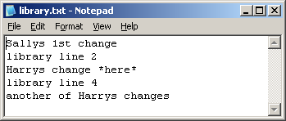
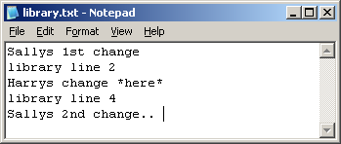
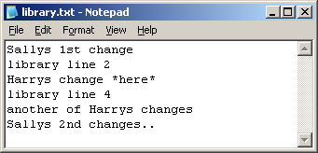
The Working Cycle
Exercise IV: conflicts
update harrys working copy to get sallys last changes
change the fifth (last) line in Harrys workingcopy
commit Harrys changes as „Harrys 2nd changes in our library“
change the fifth (last) in Sallys workingcopy and try to commit
update Sallys workingcopy
edit and resolve the conflict:
commit Sallys changes as „Sallys changes added“

Slide 39
Locking

Slide 40
Locking
Copy-Edit-Merge Model
The default model of Subversion is the “copy-edit-merge” model.
  This means:
    Check out a working copy
    Make any edits
    Merge changes from server
    Commit your changes
But there are situations in which this model might cause problems:
    Binary files
    central files with lot of user changes

Slide 41
Locking
The Two Models
You can’t use the “copy-modify-merge” model with files like Word or Excel (this applies for other types too) because you can’t merge those files.
So you have to go another way. There are two possible solutions:
  You can lock the file before you start to edit a file of the above type (called optimistic locking). You do not have to lock a file.
  The second one is to use the “pessimistic-locking” alternative.
  You have to lock the file, otherwise it will be write-protected

Slide 42
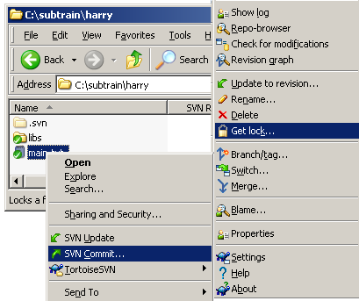
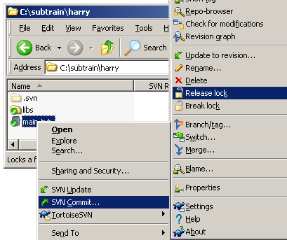
Locking
Optimistic Locking
To unlock a file just type the svn unlock command with a particular destination.
Or it will be unlocked automatically if you commit your changes back to the repository.

Slide 43
Locking
Pessimistic Locking
Pessimistic-Locking:
  You can put a special property to a file svn:needs-lock with any value.
  The result is if you check out a file with the property set, the file will be marked as read-only.
  Advantage:
    The application you use with this type of file will give you a reminder about the read-only state.
  Disadvantage:
    The system isn't flawless, either. It's possible that even when a file has the property, the read-only reminder won't always work. Sometimes applications misbehave and “hijack” the read-only file, silently allowing users to edit and save the file anyway. Unfortunately there's not much Subversion can do about this.

Slide 44
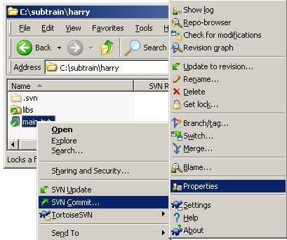
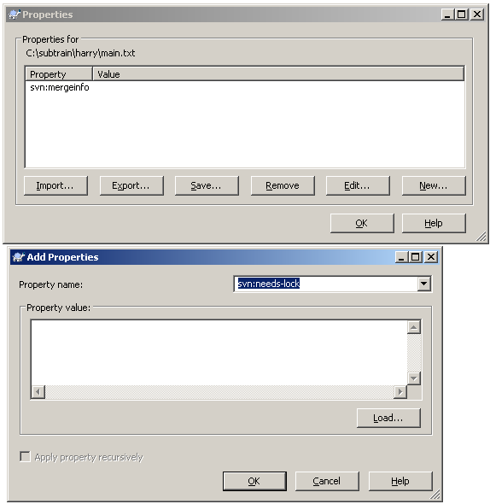
Locking
Pessimistic Locking

Slide 45
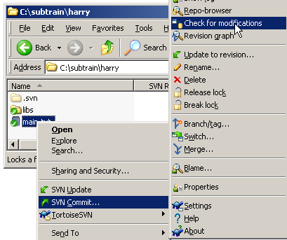
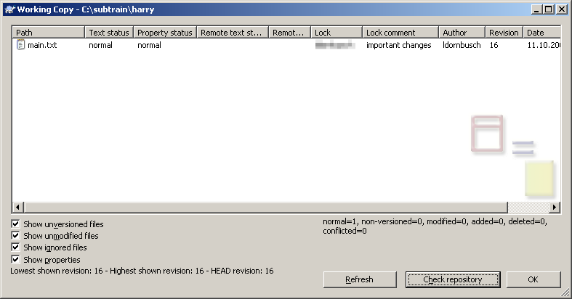
Locking
Take a look on the server..

Slide 46
Locking
Exercise V: optimistic locking
lock the main.txt in harrys workingcopy
change the main.txt in sallys working copy
try to commit sallys changes
change main.txt in harrys workingcopy
commit changes as „changes to locked file“
revert sallys changes
update sallys working copy

Slide 47
Locking
Exercise VI: pessimistic locking
set property svn:needs-lock on main.txt in sallys workingcopy
commit as "enabling pessimistic locking"
update harrys working copy
try to change main.txt in harrys workingcopy
get lock on main.txt in sallys working copy
change sallys main.txt
try to get lock on main.txt in harrys working copy
commit sallys workingcopy as „new changes to locked file“
remove svn:needs-lock and commit as „disabling pessimistic locking“

Slide 48
SVN properties

Slide 49
SVN properties
svn:eol-style
svn:executable
svn:externals
svn:ignore
svn:keywords
svn:needs-lock
svn:mime-type
svn:merge-info
do not edit this property!

Slide 50
Properties
List Properties
You can get a list of properties using the following command:
  svn proplist --verbose destination
  The Subversion “proplist”-command.
  Print out much information (verbose).
  The file/directory.

Slide 51
Properties
Get Properties
You can set a property using the following command:
  svn propget propertyname destination
  The Subversion “propget”-command.
  The name of the property e.g. svn:ignore.
  The file/directory for which the property should be set.

Slide 52
Properties
Set Properties
You can set a property using the following command:
  svn propset propertyname value destination
  The Subversion “propset”-command.
  The name of the property e.g. svn:ignore.
  The value for the property.
  The file/directory for which the property should be set.

Slide 53
Properties
Delete Properties
You can set a property using the following command:
  svn propdel propertyname destination
  The Subversion “propdel”-command.
  The name of the property e.g. svn:needs-lock.
  The file/directory for which the property should be set.

Slide 54
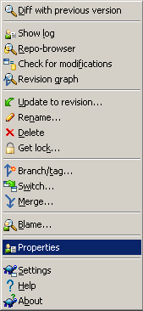
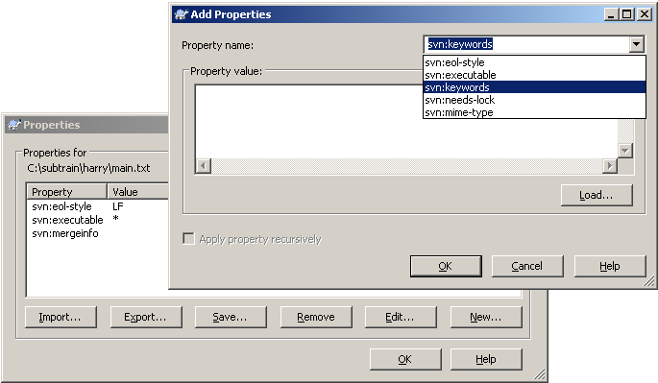
Properties
TortoiseSVN Properties

Slide 55

Properties
Special SVN Properties
svn:ignore
  Tell Subversion which files and subdirectories to ignore
  Equivalent to CVS’s .cvsignore file
  You can define a special file/directory or patterns defining the files/directories which will be ignored.
  You can suppress the exclusion if you use the --no-ignore flag for the svn status command.

Slide 56

Properties
Special SVN Properties
svn:keywords
  Keyword substitution in files.
  The only available keyword substitutions are:
    LastChangedDate, LastChangedRevision
    LastChangedBy,HeadURL,Id
  Only keywords listed in the svn:keywords property value are replaced in the file
  $LastChangedDate: 2002-07-22 21:42:37 -0700 (Mon, 22 Jul 2002) $
  $LastChangedRevision: 144 $
  $LastChangedBy: joe $
  $HeadURL: http://svn.collab.net/repos/trunk/README $
  $Id: calc.c 148 2002-07-28 21:30:43Z sally $
  Special fixed width keyword substitutions
    Use $Author:: $ instead of $Author$

Slide 57
Properties
Special SVN Properties
svn:executable
  For files only, sets the executable bit
  Useful for scripts and programs
  The executable bit is set when the property is applied to the file, not when the commit is performed
  The executable bit is removed when this property is removed from the file.
  The property value does not matter, any value will do.

Slide 58
Properties
Special SVN Properties
svn:mime-type
  SVN assumes a text file if svn:mime-type is not set or is set and
  matches “text/*”, otherwise it is a binary file.
  If a file is a text file SVN can use diff and patch to update changes from the repository.
  Useful for setting the MIME type of a file for web browsing.

Slide 59
Properties
Special SVN Properties
svn:externals
  If you use a library (source form) as part of your development
  which is used in more than one project, you can make a kind
  of a link to the repository for that library. This avoids redundant
  copys of the library’s source code.
Advantages:
  Just a single point of development for 3rd party library or libraries at all.
Disadvantages:
  No automatic commits etc. in directories which are created by svn:externals.

Slide 60
Properties
Special SVN Properties
svn:eol-style
  Native
    Convert all CR, CRLF and LF’s to the system’s native eol
  CR
    Convert all CRLF and LF’s to CR’s
  CRLF
    Convert all CR and LF’s to CRLF’s
  LF
    Convert all CR and CRLF’s to LF’s
  Property not set, this is the default when a file is added.
  Do not change end of lines upon check in or update.

Slide 61
Managing versions

Slide 62
Tagging
Why Tagging?
Why do we need tags?
  Mark a release state of a product.
  Mark a snapshot of the current development.
Typical Release names:
  Release 1.0.0, Release 2.3.1, PRODUCT 1.0.0RC1 etc.
A Tag name should be unique to mark all components of the given product (source code and documentation) and is used to reproduce the state of the tag in the future.

Slide 63
Tagging
Why Tagging?
If we take a look at the architecture chapter we really don‘t need a special tag. We only need to write down the revision number.
But human beings have other requirements.
They like to have self-explanatory tag names which are more handy.
But the question is:
  Where to put the tag information in the repository?

Slide 64








Tagging
Tagging by Copy
Root
Project 1
trunk
To create a release tag just copy …
…anyway you have the revision number …
tags
Release 1

Slide 65
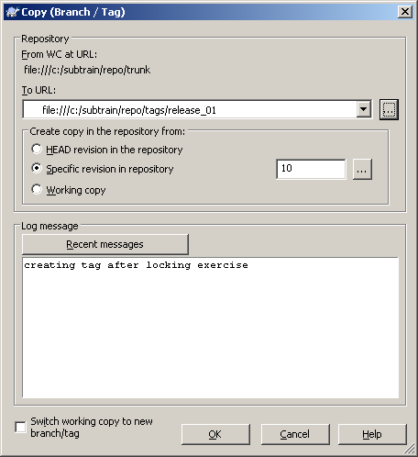
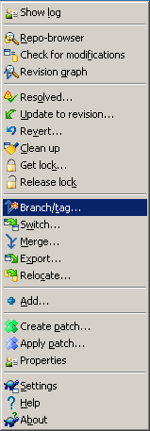
Tagging
Exercise VII: tagging
Tagging
Exercise VII: tagging
create a tag named „/tags/release_01“ with
commit message
„creating tag after locking exercise“

Slide 66
Branches
Why Branching?
Assume the following situation:
  You have created a great product and it has been delivered to your customer.
  Before you delivered the product you have created a tag, let us name it „Release 1.0.0“
  Your current development crew is working on Release 1.1.0 with new features.
And now Murphy‘s Law caught you:
  Your customer calls you and reports that he has found a bug in your software.

Slide 67

Branches
Why branching?
The development has continued after the release of RELEASE 1.0.0
You want to fix the bug
to satisfy your customer!
In your current development
you have enhanced many of
the product’s functions
but you don‘t want to deliver
a product with more
features and you haven‘t
finished testing yet.
How to solve this situation?
RELEASE 1.0.0
Main line of development

Slide 68

Branches
Why branching?
Based on the tag you‘ve created during the delivery you can check out the exact state of the delivery.
You create a Branch to
fix the bug in the software.
After you have fixed the bug
you can tag the Branch and
deliver another version to the
customer.
Your customer is satisfied
that you fixed the bug
so fast.
You haven‘t disturbed the
current development.
RELEASE 1.0.0
BUGFIX_BRANCH
RELEASE 1.0.1

Slide 69
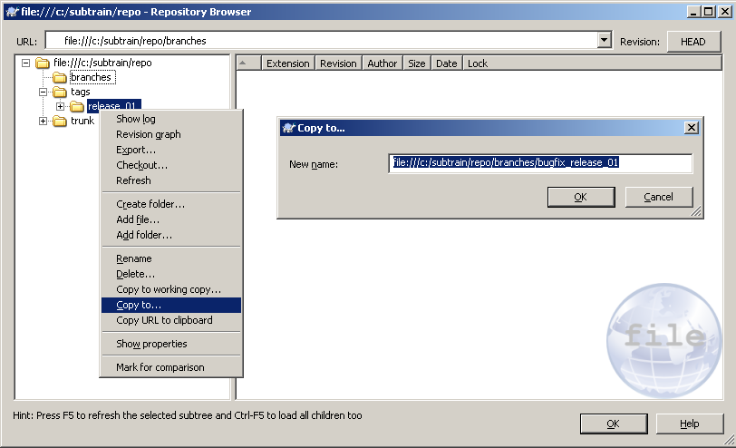

Branches
Creating branches by copy
Root
trunk
tags
release_01
branches
bugfix_release_01

Slide 70
Branches
Creating branches
You can create a branch using the following command:
  svn copy source destination
  The Subversion “copy”-command.
  The source of the operation may be the local working copy.
  The destination of the operation. This means the name
  of the Branch.

Slide 71
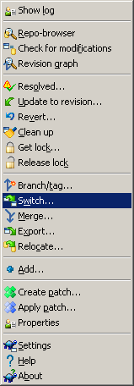
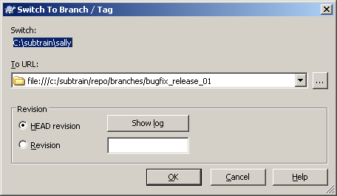
Branches
Switching branches
If you want to work on a different branch, you can „switch“ your working copy instead of a new checkout.
  svn switch url path
  The Subversion “switch”-command.
  The url where your working copy should point to.
  The path of your working copy.

Slide 72
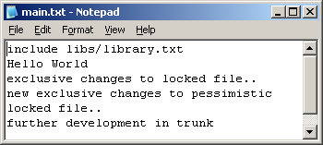
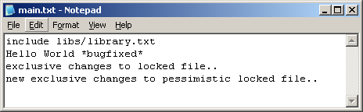
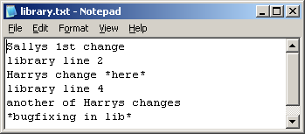
Branching
Exercise VIII: branching
create a branch named „/branches/bugfix_release_01“ with
commit message
„creating branch for bugfixing“
Switch Sallys working copy to this new branch
add a line in Harrys main.txt and commit it as „making progress in trunk“
change Sallys main.txt and libs/library.txt:
commit Sallys changes as „bugfixing on branch“

Slide 73
Branching strategies

Slide 74


Branching Strategies
Developer Branches
Separation of team members can be realized with branches.
One branch per team member or several members on a branch - the decision is based on the size of the teams.
Main line
Member 1
Member 2

Slide 75
Branching Strategies
Developer Branches
Advantages using branches for team work:
    No changes during development on the main line needed => Code stability.
    Every team member can work in its own environment.
Disadvantages:
    Sometimes the mainline and the branch will diverge if the branch lives too long.
    large merge effort for maintainer of trunk

Slide 76



Branching Strategies
Feature Branches
Separation by features (one branch each).
Branch will be obsolete after merge
trunk will progress in
atomic features
Main line
Feature 1
(new UI)‏
Feature 2
(multilinguality)‏

Slide 77
Branching Strategies
Platform Branches
branches will live as long
as the platform is supported
Main line
Plattform 1
(UNIX)‏
Platform 2
(Windows)‏

Slide 78
Branching Strategies
Vendor Branches
Important, if you get distributions of 3rd party source code which contains your own modifications:
new versions of source code will be placed into a branch and replaces the old version svn_load_dirs.pl will help to keep track of file movements/additions/deletions
changes between versions will be merged into /trunk/vendor_dev
trunk
vendor_dev
tags
vendor_1.0
vendor_1.1
vendor_1.2
2.
vendor_branch
1.
  svn_load_dirs.pl

Slide 79
Merging

Slide 80

Merging
Merging from a branch
What’s with the bug you've fixed on the bug-fix-branch?
What about your current development?
You have to merge the
changes made in the branch
back to the main line.
RELEASE 1.0.0
BUGFIX_BRANCH
Merge back

Slide 81
Merging
Merging means: applying a „patch” to your wc
a merge will always apply a “patch” to a workingcopy
a patch is always a difference between two versions/trees
in this sample below we create the patch between revision 4 and 7
Δ4
Δ6
4
6
7
branch
branch
Δ3
merge
Δ8=Δ4+Δ6
trunk (wc)‏
3
5
8
Δ5
Δ8

Slide 82
Merging
Best Practices:
  If you need to create a branch, you should do it from a completely committed working copy. This prevents you from becoming confused.
  If you merge check out a clean copy into another directory.
    Otherwise you can't go back using “svn revert”.
    After you've merged commit the changes and provide a log message with information on which revision/branch you have merged (merge tracking).
    You can first test the merge using the --dry-run flag of the merge command.

Slide 83
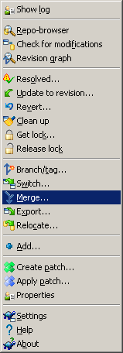
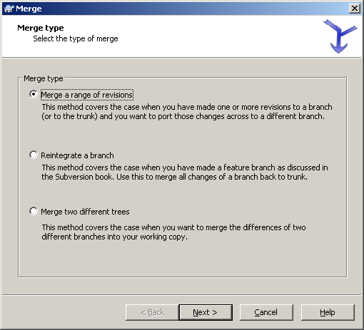
Merging
reintegrate branch

Slide 84
Merging
Reintegrate branch
reintegrate branch will keep track of all previous merged revisions and will
not try to merge them back
conditions apply:
no switched working copy
all revisions from trunk has to be merged into branch before
(so example below will not work if only 5 or 7 is merged to branch)‏
Δ4
Δ8
4
6
8
9
10
featurebranch
branch
Δ5
Δ11=Δ4+Δ8
Δ3
Δ7
merge
trunk (wc)‏
3
5
7
11
Δ5
Δ7

Slide 85
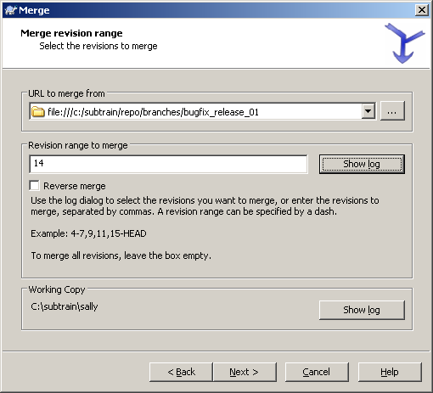
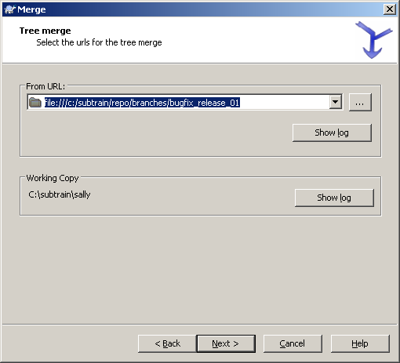
Merging
merge a range of revisions
reintegrate a branch

Slide 86


Merging
merge two different trees

Slide 87

Merging
Mergetracking in svn log
merge tracking

Slide 88
Merging
Exercise IX: merging
Switch Sallys working copy back to /trunk
merge the appropriate revision(s) from /branches/bugfix_release_01/ into sallys working copy
check if the merge add the bugfix into the trunk
commit Sallys changes as:
„merged bugfix from branches/bugfix_release_01 rev13:14 into trunk“
as this you have somekind of human readable merge tracking
control the mergetracking with TortoiseSVNs „show log“

Slide 89
SVN configuration

Slide 90
Subversion Configuration
Under Linux you will find the configuration under:
  /home/Username/.subversion/config
Under Windows you will find the configuration under:
  %APPDATA%/subversion/
  In the config file [config.txt] you can change the behaviour of parts of Subversion.
  in the server configuration file [servers] you can setup proxy-server settings and ssl authorities

Slide 91


SVN configuration

Slide 92
Subversion Configuration
auto-properties
Auto-properties can be useful if you like to set Word/Excel files to read-only.
  You have to turn on enable-auto-props which means set it to „yes“.
  After that you can set svn:needs-lock for particular file types.

Slide 93

Subversion Configuration
auto-properties
[auto-props]
### The format of the entries is:
### file-name-pattern = propname[=value][;propname[=value]...]
### The file-name-pattern can contain wildcards (such as '*' and
### '?'). All entries which match will be applied to the file.
### Note that auto-props functionality must be enabled, which
### is typically done by setting the 'enable-auto-props' option.
# *.c = svn:eol-style=native
# *.cpp = svn:eol-style=native
# *.h = svn:eol-style=native
# *.dsp = svn:eol-style=CRLF
# *.dsw = svn:eol-style=CRLF
# *.sh = svn:eol-style=native;svn:executable
# *.txt = svn:eol-style=native
# *.png = svn:mime-type=image/png
# *.jpg = svn:mime-type=image/jpeg
# Makefile = svn:eol-style=native

Slide 94
Subversion Configuration
global-ignore
You can put whatever file extension into
global-ignores to globally ignore files of a particular type.
[miscellany]
### Set global-ignores to a set of whitespace-delimited globs
### which Subversion will ignore in its 'status' output.
# global-ignores = *.o *.lo *.la #*# .*.rej *.rej .*~ *~ .#* .DS_Store

Slide 95
Subversion Configuration
commit-times
Sometimes you need to have the changed time to be set on the commit-time instead of the created local time. This is often used in relationship with Make-files.
You can simply uncomment the line with “use-commit-times = yes“.
After that every check out will set the time stamp to commit time and not to the check out time.
### Set use-commit-times to make check out/update/switch/revert
### put last-committed timestamps on every file touched.
# use-commit-times = yes

Slide 96
Additional Links and References
Book: Version Control with Subversion:
  http://svnbook.red-bean.com/
Subversion Developer Portal and downloads:
  http://subversion.tigris.org/
Subversion Wiki:
  http://www.subversionary.org
Subversion Free Tools:
  http://subversion.tigris.org/links.html
  http://www.polarion.org
Subversion Forums:
  http://www.svnforum.org/
Subversion News
  http://svn.haxx.se/

Slide 97
Any Questions?

Slide 98
SVN Command reference

Slide 99
SVN Command reference
add
blame (praise, annotate, ann)‏
cat
changelist (cl)‏
checkout (co)‏
cleanup
commit (ci)‏
copy (cp)‏
delete (del, remove, rm)‏
diff (di)‏
export
help (?, h)‏
import
info
list (ls)‏
lock
log
merge
mergeinfo
mkdir
move (mv, rename, ren)‏
propdel (pdel, pd)‏
propedit (pedit, pe)‏
propget (pget, pg)‏
proplist (plist, pl)‏
propset (pset, ps)‏
resolve
resolved
revert
status (stat, st)‏
switch (sw)‏
unlock
update (up)‏

